Slide 1

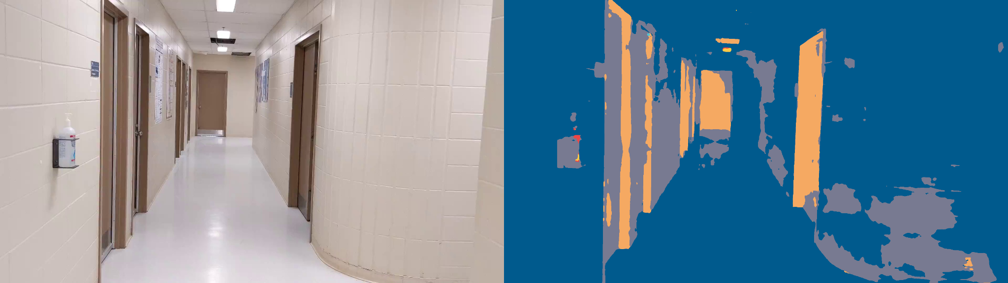
Segmentation of an Indoor Environment Based on Material Textures
Hydrogen Research Institute
Technical Guide -
Prepared by Ghassene TANABENE
Supervised by Mr. Ahmed DHAHRI, Mr. Ali AMAMOU, Mr. Lotfi ZEGHMI
05/08/2021 -

Slide 2
Table Of Contents
Data Preparation
Adapting codes for a custom dataset
Cloud Computing
Model Training
Tests

Slide 3
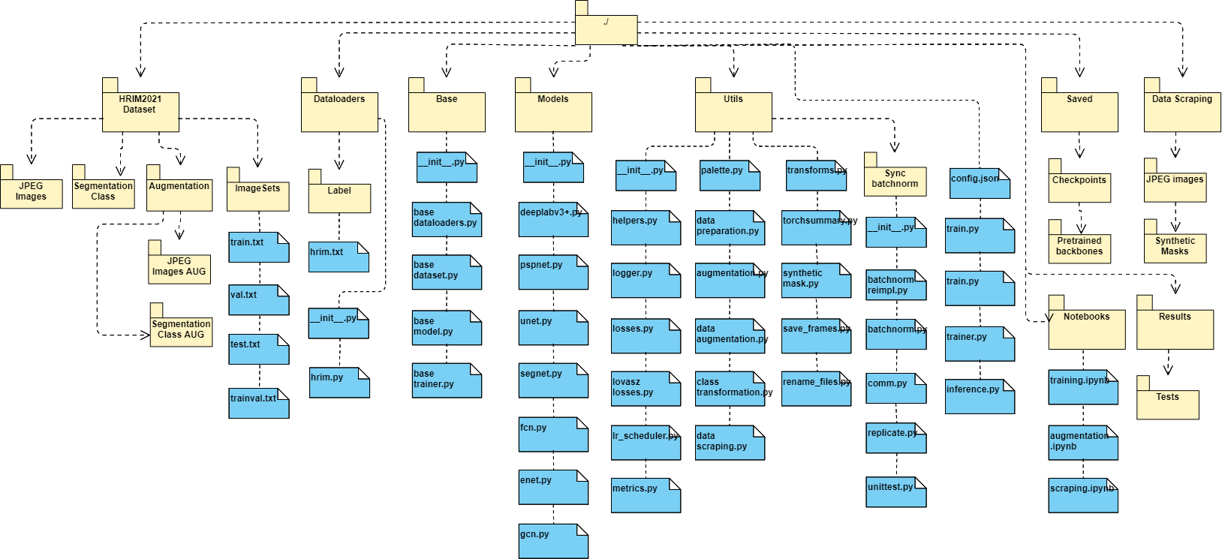
Code structure
Github : https://github.com/…

Slide 4
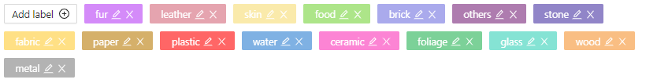
i. Data pREPARATION
Data Annotation
After gathering images containing materials in indoor scenes, we have to prepare the pixel-wise annotations manually.
In our work, we used the computer vision annotation tool for the task of semantic segmentation.
Link : https://cvat.org/
Step 1 : Create a new project
Step 2 : Create new task and configure labels of materials (segmentation classes)
Step 3 : Upload the original images in the task
Step 4 : Start annotation. We can follow these tutorials :
https://drive.google.com/file/d/1zFKveXn82fudW71YJMA2xRLL27w9KryE/view?usp=sharing
https://www.youtube.com/watch?v=Fh8oKuSUIPs

Slide 5
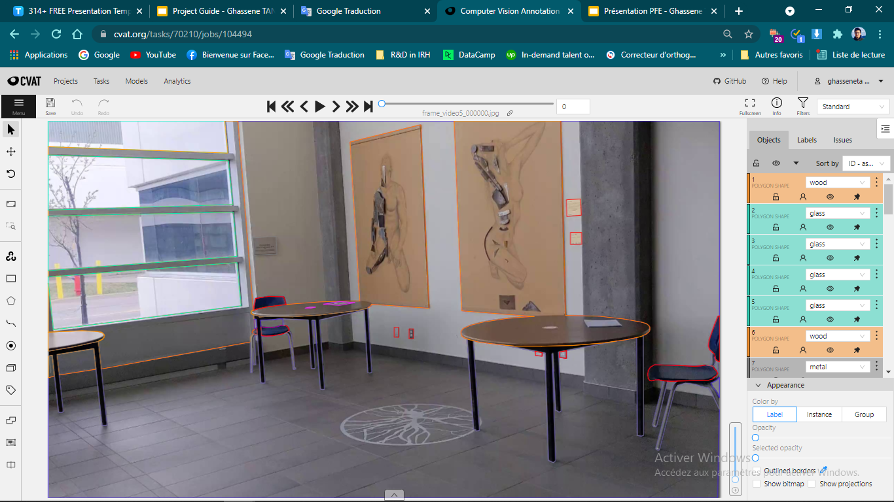
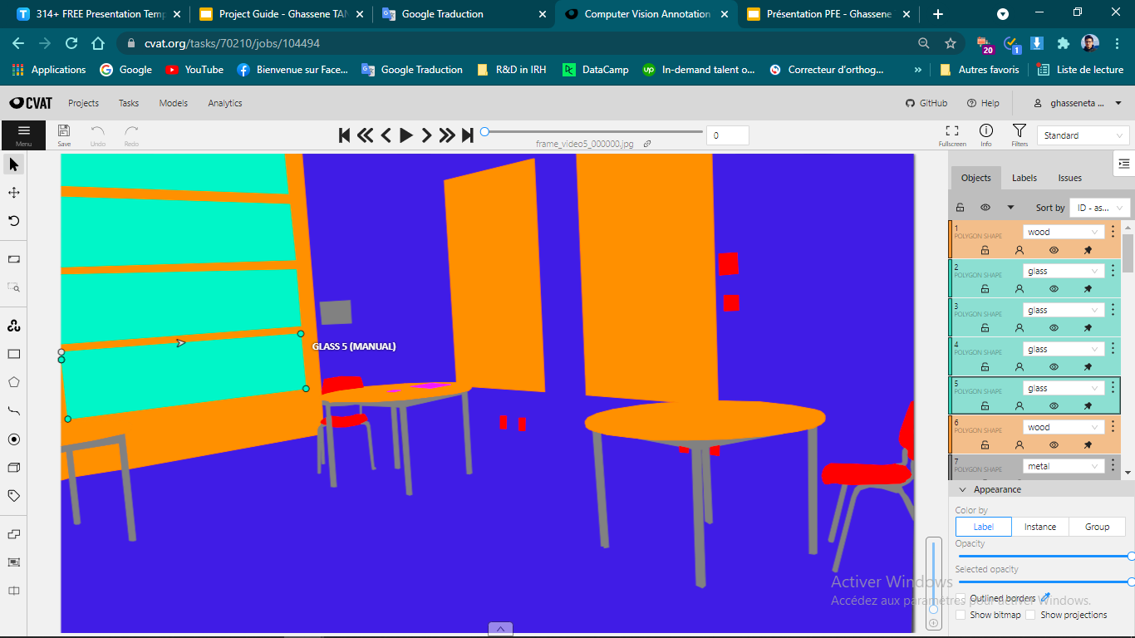
Original Image
Segmentation Mask

Slide 6
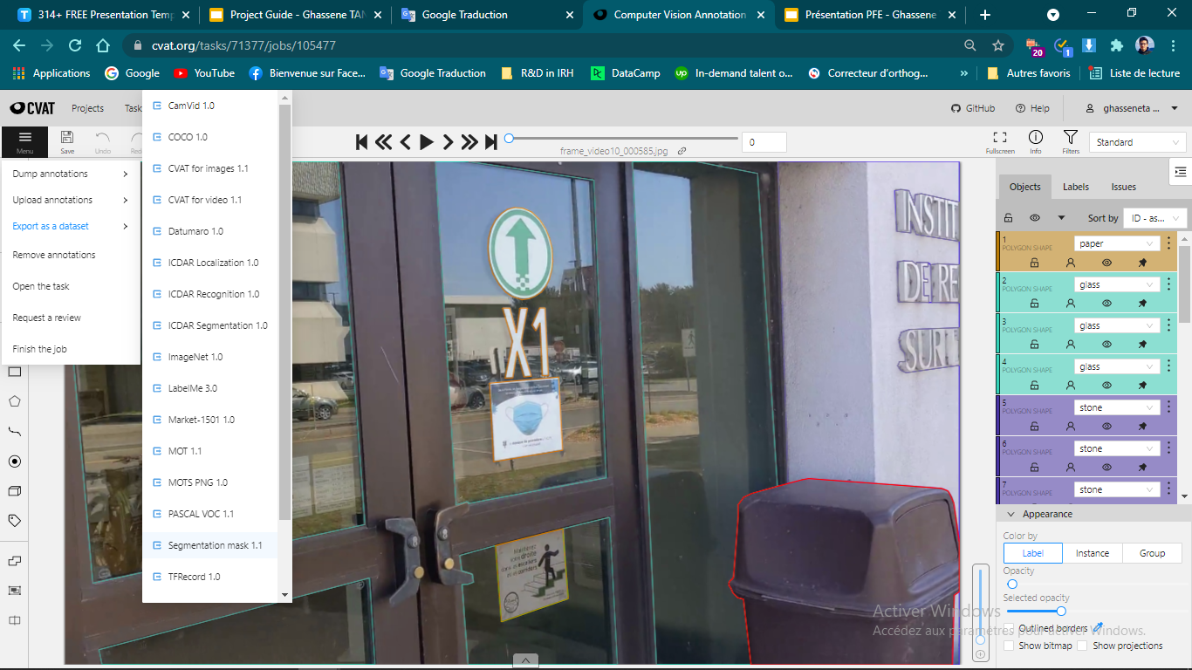
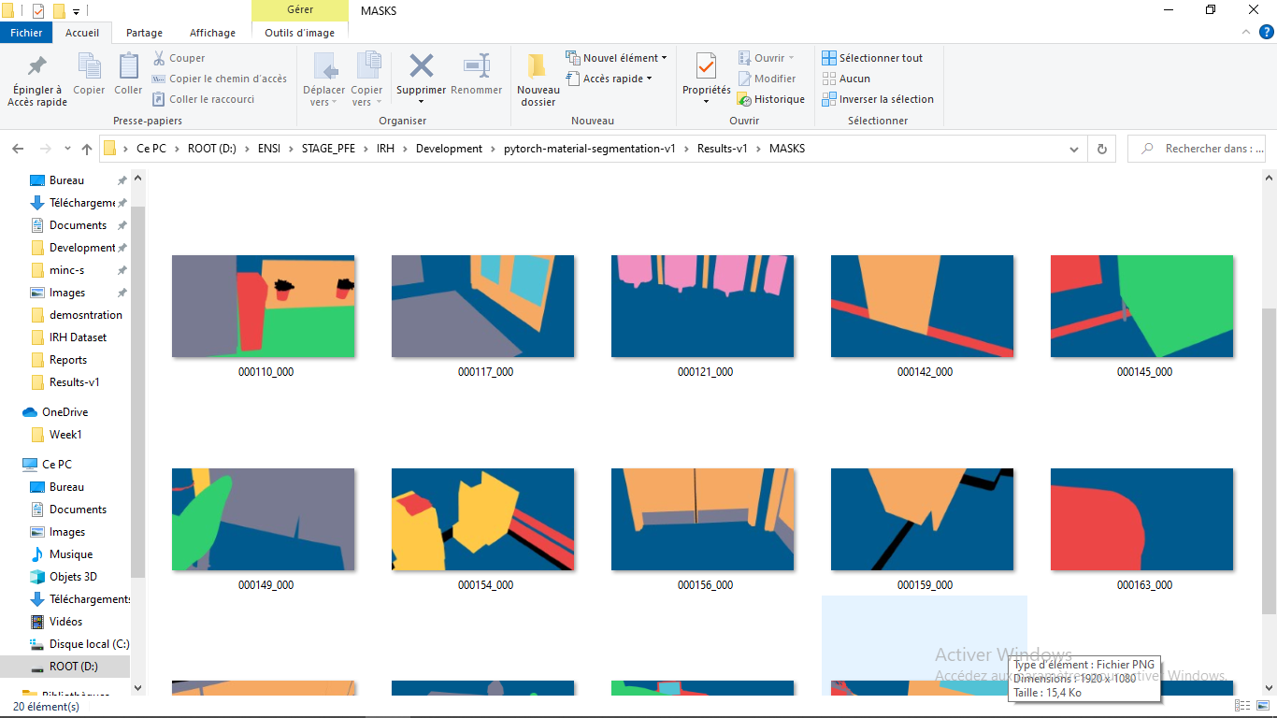
Step 5 : After preparing the pixel-level annotations of our data, we download
masks from the CVAT in the png format.

Slide 7
2- dataset Preparation
HRIM2021 (Hydrogen Research Institute Materials 2021) :
Our dataset is composed of three parts :
JPEGImages : folder containing the original images
SegmentationClass : folder containing masks in the png format having
the same id_image of the original images and also the same dimensions.
ImageSets : containing the following text files :
train.txt
val.txt
test.txt
trainval.txt

Slide 8
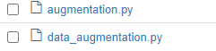
3- DAta augmentation
To avoid model overfitting, we used Albumentations, the python library for image augmentation to do spatial-level transformations and pixel-level transformations for both images and masks.
To prepare augmented data, we can simply run:
!python ./utils/data_augmentation.py --JPEGImages path_to_images_folder --SegmentationClass
path_to_png_masks_folder --output output_folder

Slide 9
iI. Adapting codes to a custom dataset
To train our model, we used models from https://github.com/yassouali/pytorch-segmentation . The original code used Pascal Voc dataset, Cityscapes, ADE20k and Coco which are general context datasets.
To adapt the code to our specific use case using HRIM2021 (Hydrogen Research Institute Materials 2021), we made these changements.
______TODO_______ | Pascal VOC 2012 | HRIM 2021
We followed the same steps used for pascal voc 2012 dataset after tasting it and we make some changements. | ./dataloaders/labels/voc.txt | hrim.txt
 | ./dataloaders/voc.py | hrim.py
 | ./dataloaders/__init__.py | /__init__.py -> import .hrim
 | ./config.json | config with HRIM2021
 | ./inference.py | add 'HRIM'
 | ./utils/palette.py | add hrim palette
 | ./dataset/ImageSets | change *.txt files
 | in pascal Segmentation Class Augmented folder, the masks are not RGB. They are images containing class_label instead of color code. | We added conversion function from RGB color to class_label for masks. (We can also use masks in class_label format like pascal instead of conversion.)

Slide 10
The changements may lead to many issues. These are some errors and the corresponding solutions.
DEBUGGING | custom dataset errors | solution
1 The solution causes error 3 | trainer.py assert output.size()[2:] == target.size()[1:] line 64 should have #output size : torch.Size([8, 17, 513, 513]) | add : label = np.argmax(Image.open(label_path),2) + label = np.asarray(label, dtype=np.int32)
 | #target size : torch.Size([8, 513, 513]) instread of #output size : torch.Size([8, 17, 513, 513]) | https://github.com/yassouali/pytorch-segmentation/issues/68
 | #target size : torch.Size([8, 513, 513, 3])
2 | err1 resolved caused ValueError: Expected more than 1 value per channel when training, got input size torch.Size([1, 256, 1, 1]) | fixed by changing batch size = 2^n https://github.com/yassouali/pytorch-segmentation/issues/2
3 | we have outputs with only 3 classes predicted (3 colors background & 2 classes) & class_iou = 0.0 for the other classes => problem in the masks that shouldn't be RGB format | https://github.com/yassouali/pytorch-segmentation/issues/72
 |  | https://github.com/martinkersner/train-DeepLab/blob/master/utils.py
 |  | https://github.com/yassouali/pytorch-segmentation/issues/2
 |  | https://github.com/yassouali/pytorch-segmentation/issues/56
 |  | https://github.com/DrSleep/tensorflow-deeplab-resnet
 |  | solution : convert_from_color_segmentation (label id in the mask) + change palette dict= {(R,G,B) : class_id} https://gist.github.com/DrSleep/4bce37254c5900545e6b65f6a0858b9c https://github.com/martinkersner/train-DeepLab/blob/master/utils.py

Slide 11
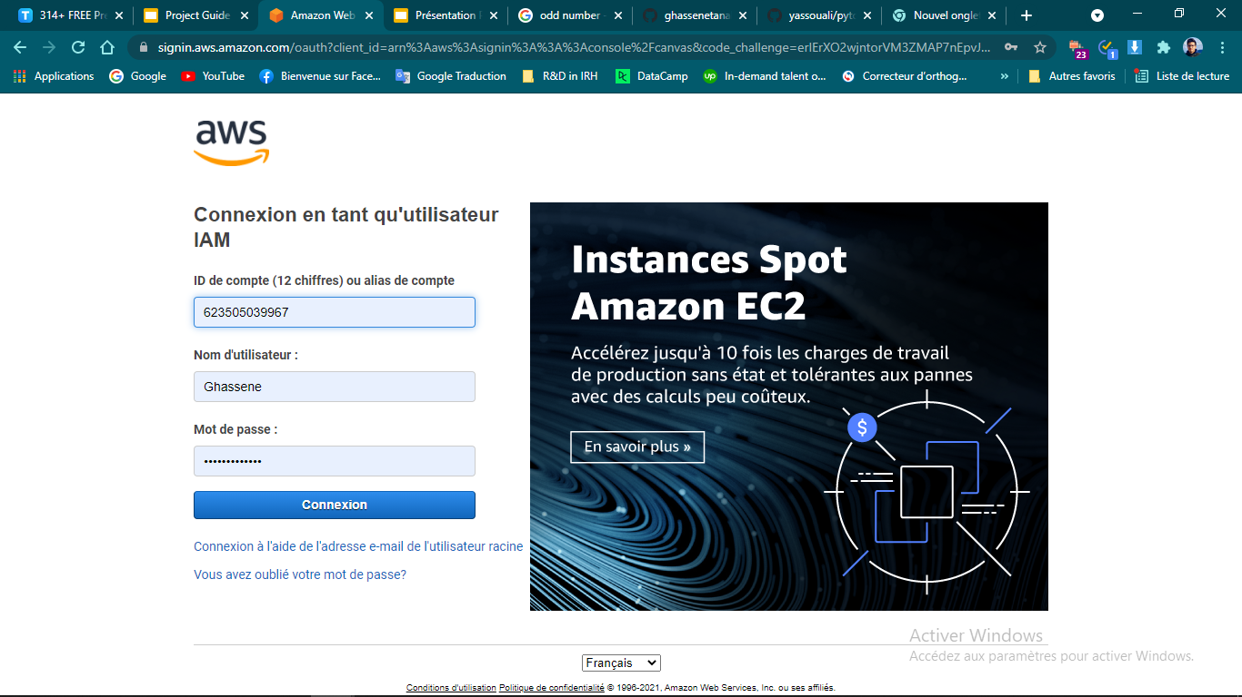
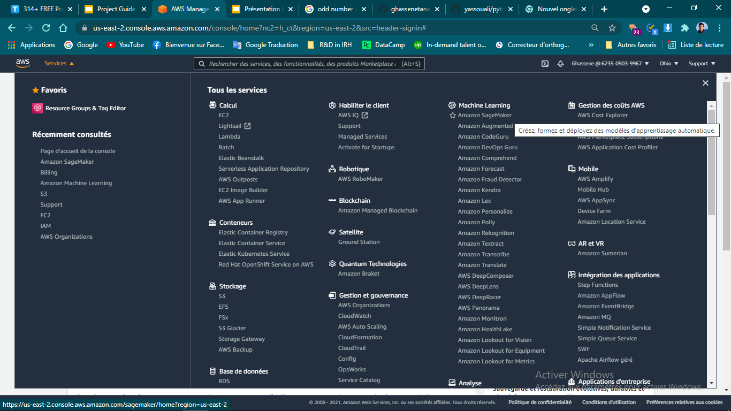
iII. Cloud computing
Since we have to use GPU to speed up the model training, we used in our work :
Google colaboratory : https://research.google.com/colaboratory/
Amazon Web Services
In AWS, we tested EC2 and sagemaker services and finally we used AWS sagemaker with EBS storage.
The recommended (price) instances for deep learning tasks are :
P2 family : we recommend p2.xlarge
G4 family : we recommend g4dn.xlarge
Step 1 : Connect to the console
Step 2 : Services -> ML -> Amazon Sagemaker

Slide 12
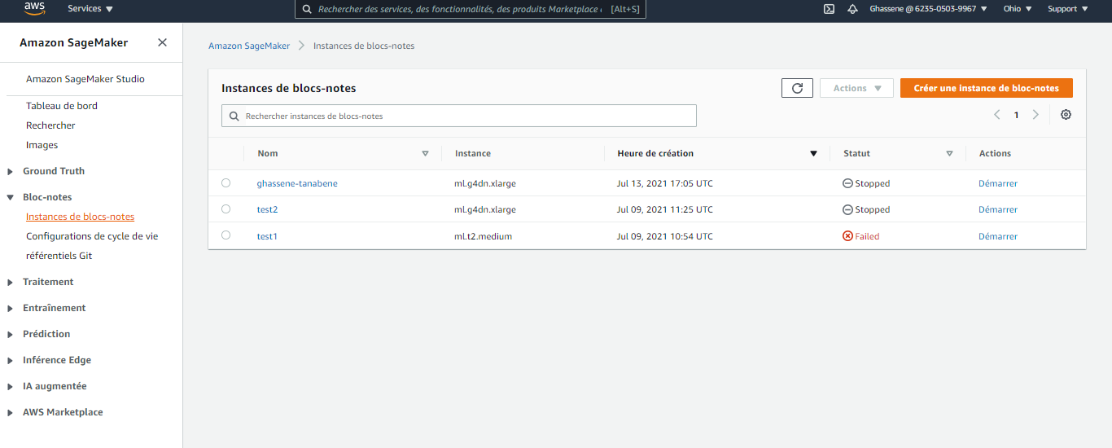
Step 3 : Choose Notebook -> Instances -> Create a Notebook Instance

Slide 13
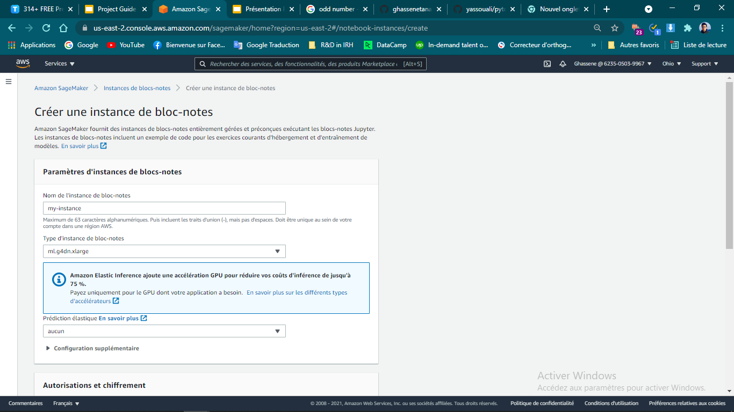
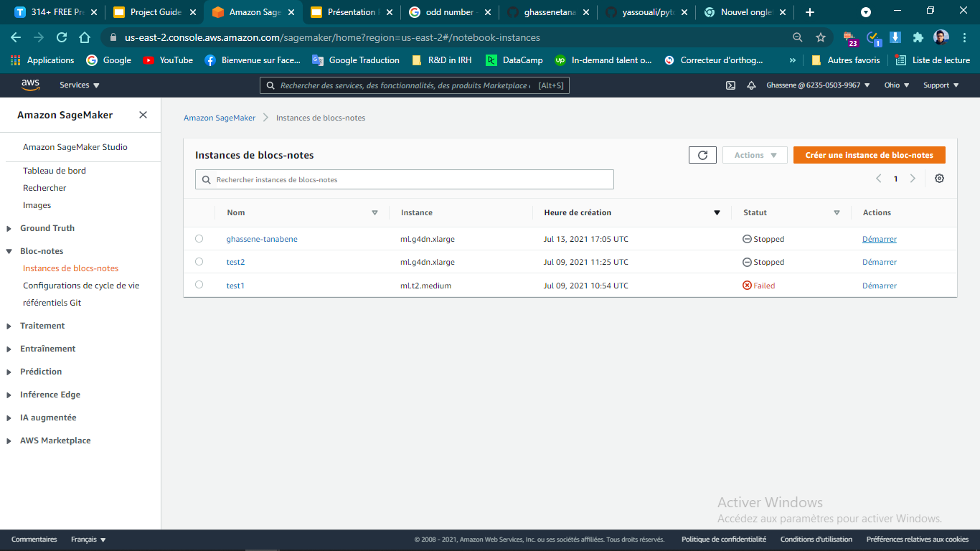
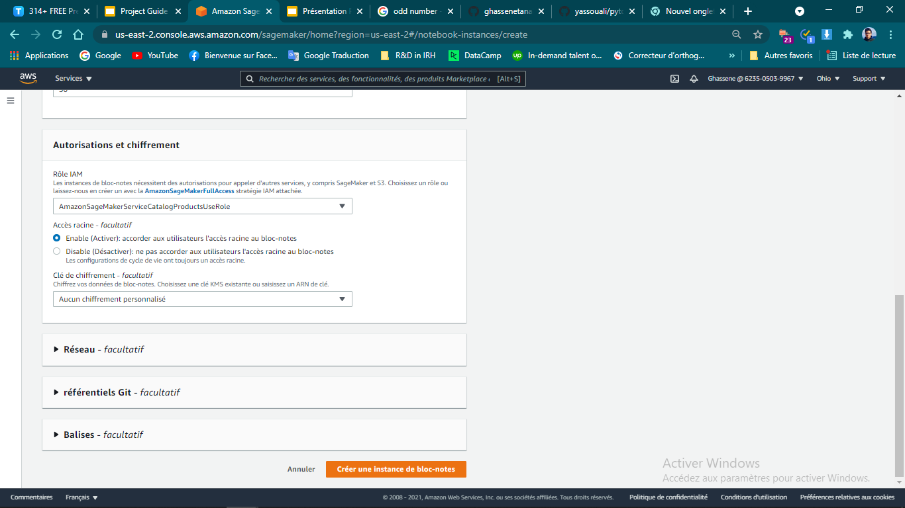
Step 4 : Configure your instance
Step 4 : Launch your instance
Step 5 : Upload your project on your instance.
(You can use s3 bucket instead of EBS storage. By default, we have 5 GB for storage, so we can edit it anytime)

Slide 14








iV. Training
Install requirements
We install the python libraries with this line command :
!pip install -r requirements.txt

Slide 15
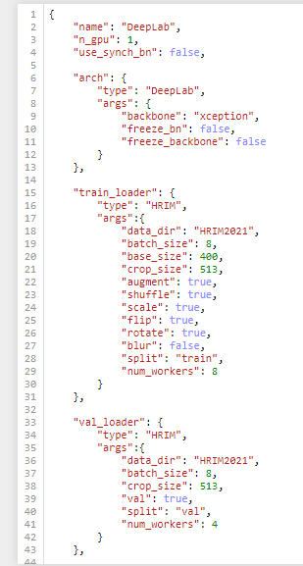
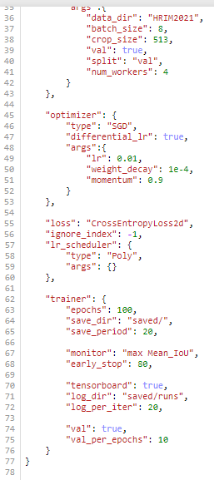
2. fine tuning
Before starting the training, we must choose the model architecture to use. After that, we have to change the parameters in the configuration file : ./config.json

Slide 16
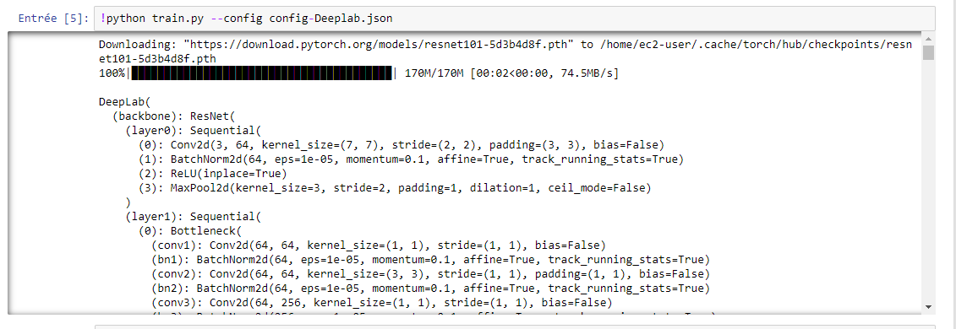
3. Training
The training will automatically be run on the GPUs (if more that one is detected and multipple GPUs were selected in the config file, torch.nn.DataParalled is used for multi-gpu training), if not the CPU is used.
To start training, we can simply run :
!python train.py --config path_to_config.json
We can also use the training notebook and run the following cell :

Slide 17
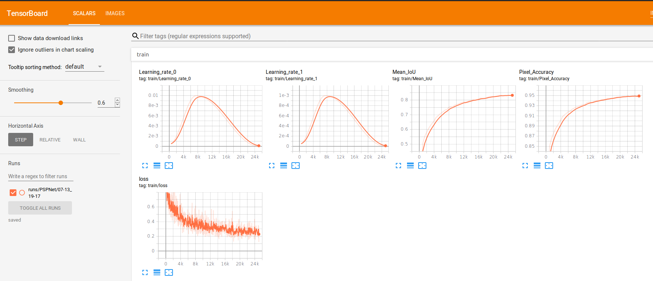
4. Visualization
The log files will be saved in saved\runs and the .pth checkpoints in saved, to monitor the training using tensorboard.
Please run this command line :
!tensorboard --logdir saved

Slide 18
V. Tests
1. Palette
In this work, we are using only 8 material classes that are the most widespread in indoor environments since the preparation of more specific categories is very time consuming. Considering the time limitation, we regrouped some specific types of materials to general classes ( e.g. : leather belongs to fabric class), and we adopt this palette to describe the segmentation classes :
The RGB color codes are written in this file : ./utils/palette.py

Slide 19
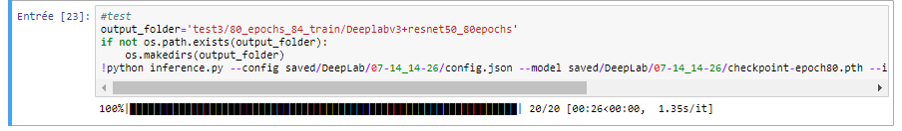
2. Inference
For inference, we need a PyTorch trained model : ./saved/model/checkpoint.pth, the images we would like to segment and the same configuration used in the training ./saved/model/date/config.json.
Then we run this line command :
!python inference.py --config path_to_config.json --model path_to_model.pth --images images_folder --output
output_folder
We can also use the training notebook and run the following cell :

Slide 20
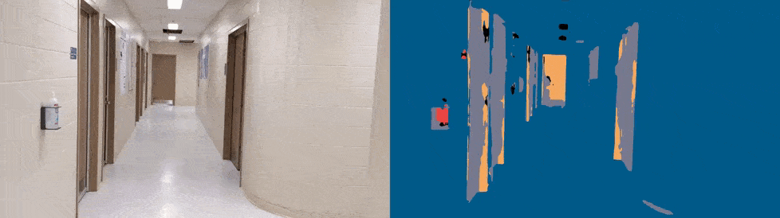

Slide 21
THANK YOU
Contact :
ghassene.tanabene@gmail.com
https://www.linkedin.com/in/ghassene-tanabene/
(+216) 50348990

